Slide 1
Network Monitoring Tool
REVIEW 2 – Different tools included

Slide 2
OVERVIEW
A Network monitoring is the heart of a server. Network Monitoring tool is needed when system analyst needs the data in figures and graphs and want to analyze the nodes connected. Through this network monitoring tool, one will be able to analyze the whole server and it’s CPU Usage, Packets deliverance, Connections, Bandwidth, Memory and many more things.
Different tools will be included in the package with 1 welcome prompt to choose from the options given and the outputs will be given graphically on shell.

Slide 3
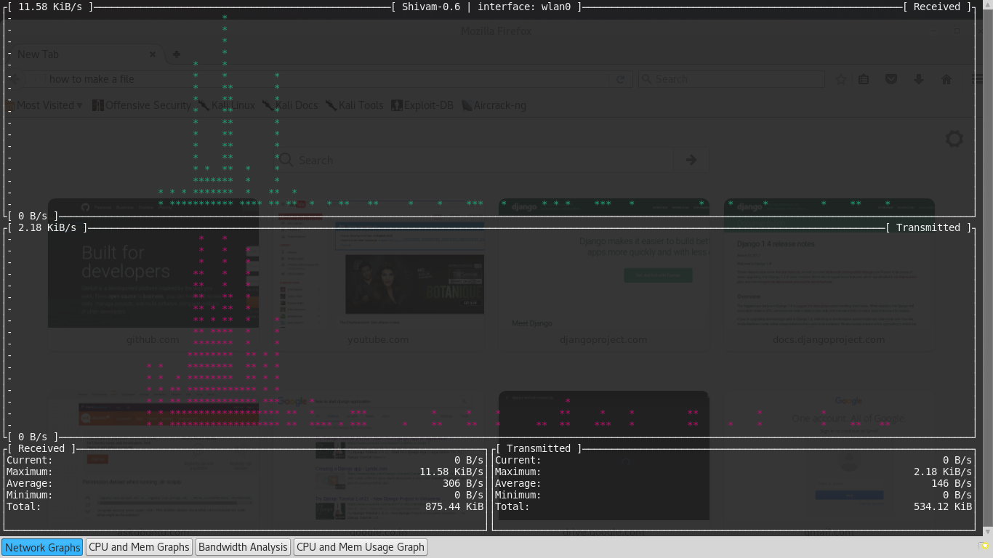
1st TOOL – UPLOAD AND DOWNLOAD MONITORING

Slide 4
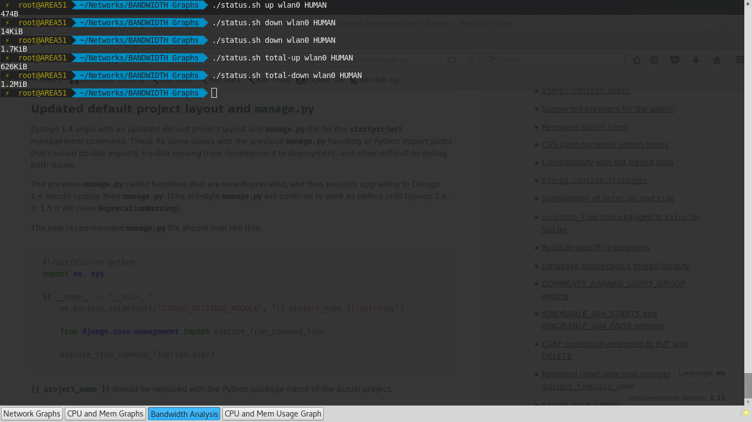
2nd TOOL – UPLOAD AND DOWNLOAD MONITORING (Single interval)

Slide 5
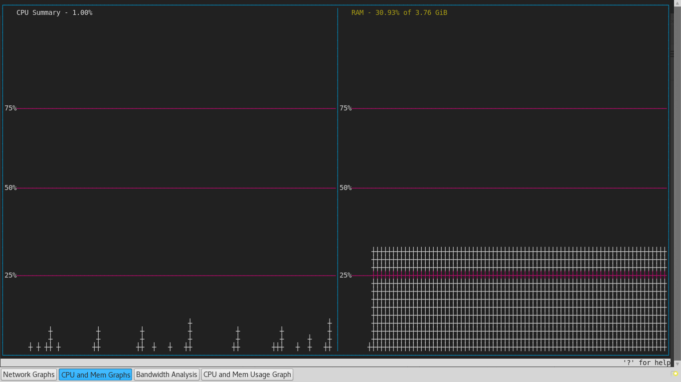
3rd TOOL – CPU – MEM GRAPHS

Slide 6
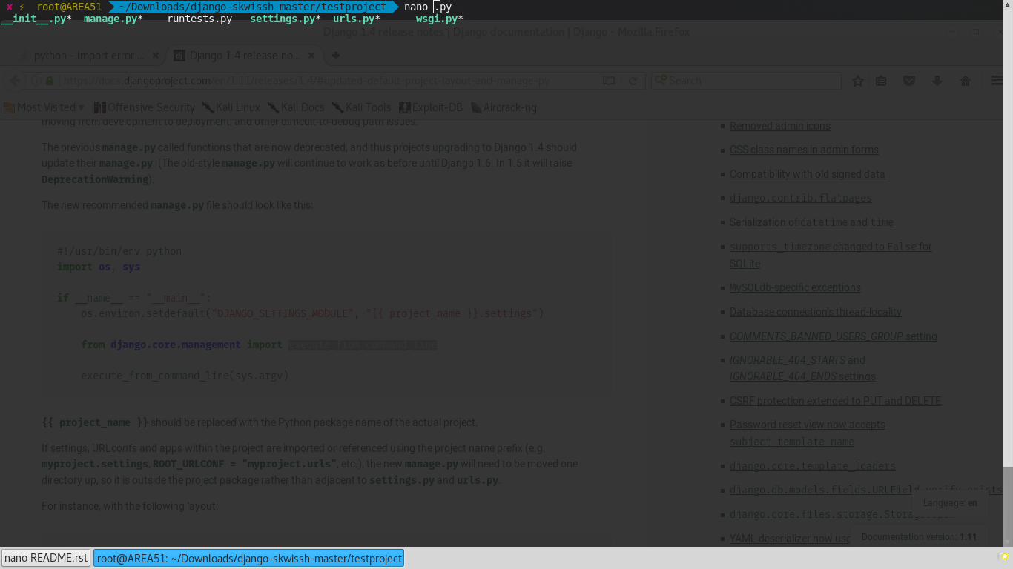
4th TOOL – CPU – MEM DATA (single interval)

Slide 7
FUTURE WORK
To incorporate all tools into 1 welcome file with options to choose tools.
To add packet counting tools and connected nodes graph.
To build the whole package as executable.
Try to implement graphs on web platforms (if possible), otherwise graphs on shell are visible.
To create a dashboard (if possible).

Slide 8
NETWORK MONITORING TOOL
SHIVAM KAPOOR (15BCE1339)
ABHISHEK SINGH (15BCE1009)

